Slide 1
Contraception
Sexual Health Promotion Lead
Calderdale Sexual Health Service

Slide 2
Groundrules
We will neither ask nor answer any personal questions.
We will respect each other and not laugh at each others questions.
We will not discuss anything that we want to be kept confidential.
We can pass or opt out if something makes us feel uncomfortable.
Only correct names for parts of the body to be used

Slide 3
Legal issues
Legal Age of consent to sexual activity is 16yrs old, regardless of sexual orientation.
However, contraception can be provided to someone under 16 if a clinician thinks this is in the best interests of that person.
Anyone attending a sexual health clinic has a right to confidentiality, including those under 16.
Notes:
Important to stress that legislation exists to protect children from harm and exploitation and someone cannot legally consent to sexual activity if they are under 16. However, legislation is not designed to criminalise normal teenage curiosity and experimentation so where 2 people are of a similar age, and both agree to the activity the police can take the decision not to prosecute. This applies between 13 and 16yrs. Anyone under the age of 13yrs cannot consent, nor can any consent or agreement be taken into account therefore a statutory offence will have been committed.
Services can support young people and provide treatment to those under 16 where the clinician believes it is in the individuals best interest to do so. Individuals also have the right to confidentiality which means a clinician can only break confidentiality where there is a belief that a young person may come to significant harm. Even where confidentiality is ultimately broken a clinician will always try to discuss with the young person why they have a concern and ask for the childs permission to speak with someone else, although this is not necessary where a young person is at risk of harm. Concerns would usually go through to a safeguarding nurse / and or safeguarding referral routes or in very rare circumstances police if a child is in immediate danger.
Finally, young people are concerned parents / carers may find out so important to reassure that as a service we do not contact parents and even where a parent may contact the service for information we are under an obligation not to provide information, or even acknowledge a young person attended.

Slide 4
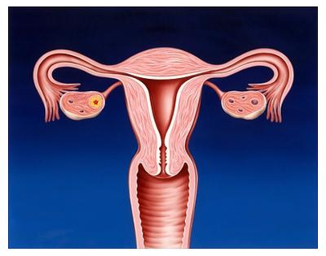
Female Reproductive Organs
Fallopian tube
uterus
(womb)
ovary
cervix
vagina
Notes:
Provide brief re-cap on menstrual cycle explaining that where an egg is fertilised it would implant in the womb and progress to pregnancy, otherwise a female would have a period.

Slide 5
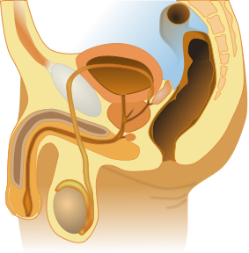
Male Reproductive Organs
bladder
Sperm duct
penis
testicle
scrotum
Notes:
Brief recap on sperm production and orgasm.

Slide 6
What is Contraception?
The deliberate use of artificial methods to prevent pregnancy as a consequence of sexual intercourse.
Notes:
Invite pupils to consider question in pairs and come up with a single sentence they might use to describe what contraception is. Usually a range of responses, some will broadly mean the same as the statement on the slide and look at what they do, whilst others will focus on specific types of contraception.
Aim of this is to help get pupils focussed on what the lesson is discussing and existing knowledge.

Slide 7
Card Match Activity
There are 15 different types of contraception, the aim of the game is to match the pictures with the names.
Notes:
Split class into smaller groups (4-5) is ideal to allow group participants to be able to engage effectively and provide them with a set of cards.
Allow them some time to have a go at the activity with little or minimal input, but be alert to groups reaching the limit of their collective knowledge and becoming distracted. After a short period then go around the groups correcting a few to help re-engage in activity.
Allow approx 15mins for activity then bring group back.

Slide 8


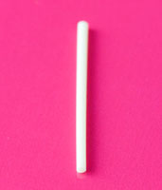
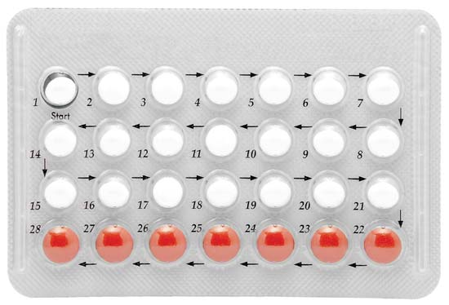
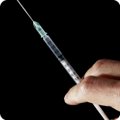
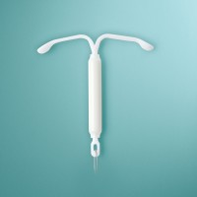
Methods; Hormonal
Implant
Patch
Combined Pill
Progesterone only pill
Vaginal Ring
Injection
IUS
Notes:
Explain the different types of contraception can be grouped together with around half on the list being classed as hormonal contraception and these all work in a particular way. Go through examples of hormonal contraception shown on slide.

Slide 9
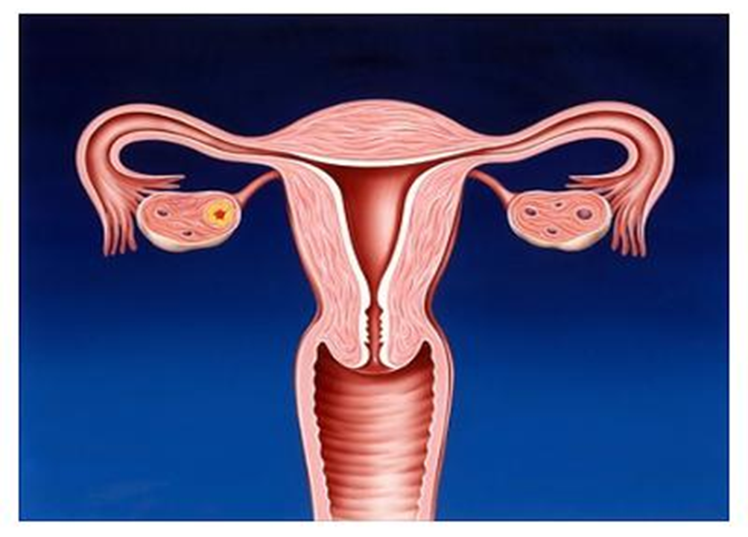
How Hormonal methods work;
Prevent Ovulation
Thins uterus lining
Thickens Mucus around Cervix
Notes:
Description of how hormonal methods work and because they work in these three different ways all hormonal contraception is extremely effective (99%+)

Slide 10
100% ?
Hormonal contraceptive, highly effective
Over 99% effective
Can be affected by;
Some medications (Enzyme inducing drugs)
St Johns wort
Vomiting / Diahorrea
Not taking it!!
Notes:
More information on effectiveness, along with how some ways in which hormonal contraception be compromised in it’s effectiveness.
Biggest cause of contraceptive failure, especially related to the pill, is simply people forgetting to take it rather than anything else so it’s important to follow instructions on contraception use to make sure it remains effective. Another useful tip is that if someone is using hormonal contraception and they visit the GP it’s worth them mentioning to the GP they are using hormonal contraception to make sure any prescription doesn’t interfere with how it works.

Slide 11
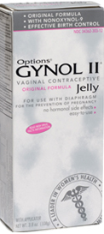
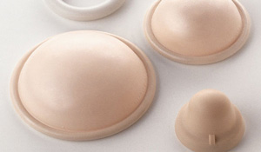
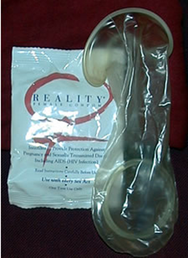
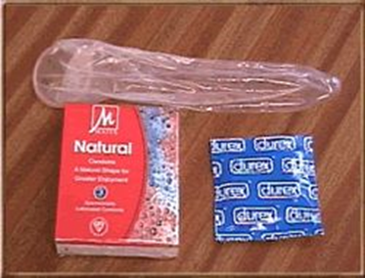
Methods; Barrier
Cap / Diaphragm
Femidom
Condom
Works by;
Preventing sperm getting to the egg.
Notes:
Description of Barrier methods.
Cap/Diaphragm; quite an old fashioned method these days although is still quite effective if used correctly. Access harder than things like condoms and femidoms as someone would need to visit the sexual health service to be shown how they are used and to get the right one for them.
Femidom: accessible but arguable a bit less easy to get hold of than condoms and definitely more expensive. Although in common with the cap / diaphragm some people prefer to use this method as it gives them more direct control over their contraceptive use.
Condom; The most commonplace and accesible form of barrier contraception and have got a long history of use with modern manufacturing methods making these extremely thin and reliable. However, disadvantage is that they are less effective than hormonal contraception and are prone to user error! Eg condoms splitting when putting on, coming off etc.

Slide 12
Barrier Methods
Less effective than hormonal contraceptive methods.
Condoms (98%)
Femidoms (95%)
Cap / Diaphragm (92 – 96%)
Notes:
More information on effectiveness. Percentages refer to effectiveness if used correctly every single time (perfect world scenario!) and practically condom effectiveness can be as low as 85% in terms of preventing pregnancy.

Slide 13


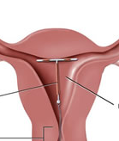
Methods; Other
Permanent
Vasectomy
Sterilisation
IUD
Natural Family Planning
IUD
uterus
Notes:
Other methods description
This slide simply highlights other methods available although these are generally used in relatively limited circumstances;
Permanent methods; As it states these would only be used once someone has made the decision not to have (more) children. Permanent methods can be reversed although success rates vary widely and generally this is not done on the NHS so a decision to have a permanent method must be thought through very carefully.
IUD (sometimes referred to as a copper coil); The copper in the coil makes the uterus hostile to sperm which reduces the likelihood of pregnancy. Can be used as emergency contraception up to 5 days after unprotected sex.
Emergency contraceptive pill; not shown as although this features in the list of forms of contraception it should only be used as the name suggests and depending on type of pill and individual circumstances can be used up to 3 or 5 days after unprotected sex.

Slide 14
Double Dutch!
Using a combination of methods; ie one barrier and one hormonal method, such as condoms and implant give the best possible protection against unintended pregnancy and STI’s
Notes:
This slide included to emphasise whilst hormonal contraception is extremely effective things can occasionally go wrong and using condoms / femidoms as a back-up method help reduce risk and have the added benefit of protecting against infections.

Slide 15
They Say / I Say
We don’t need a condom, I don’t have an STI
I can’t feel anything with a condom
We don’t need a condom it’ll ruin the moment
We don’t need condoms we’ve been seeing each other for ages
We can’t use condoms, I’m allergic
Condoms are too small / tight for me to use.
We don’t need condoms I’m on the pill.
Don’t you trust me?
Notes:
Make the point that discussion around contraception and condom use BEFORE sex is important rather than wait until the moment when you need one. This makes it less likely you’ll have any awkward moments later on, but there are times when this discussion does not take place so it’s useful to consider what you might say if someone is reluctant to wear a condom.
Split class into smaller groups of 3-6 and provide each group with 2/3 of the lines someone may use to argue against condom use. Aim of activity is to encourage students to come up with responses to push back against this type of pressure to engage in unprotected sex.
Most statements use we instead of I deliberately as whilst most pressure for not using condoms will be created through mens reluctance to wear one, it is not exclusive and important to recognise that males can also feel pressure.
Aim is to encourage students to be creative (which helps engagement) but also use facts to embed knowledge of why condoms are important.
Many STI’s are asymptomatic so if someone is sexually active then it is possible they have an undiagnosed STI, even where risk may be low (eg they have been recently tested and not had any sexual contact since previous test.
Suggested line “Just because you don’t have symptoms doesn’t mean you definitely don’t have one”
Condoms are made with very thin latex based rubber and does not reduce physical sensation in any significant way.
Suggested line “then maybe you need to find a condom that works for you”
It may be true that where people are uncomfortable, embarrassed or unprepared it may affect the ‘moment’ but practice makes using a condom simply part of the sexual activity and not a focal point.
Suggested line “the more we use them, the easier it will be and using one means there’ll be the opportunity”
STI’s can be undetected for quite a long period of time so having no symptoms is not proof of being infection free even after several weeks or even months.
Suggested line “Until we’ve both had a test and we’re sure we don’t have anything then we still need condoms”
Around 1% of people are allergic and it is possible to get non-latex condoms to overcome this barrier so if someone knows they are latex allergic then they can prepare for this.
Suggested line “Then we’ll have to wait until you can get a latex free one”
Condoms come in many shapes and sizes so it is very unlikely that someone cannot find a condom to fit.
Suggested line “you can fit a condom over someones head so I’m sure you can find one big enough”
Using the pill, like any form of hormonal contraception, is great for preventing pregnancy but does not prevent STI’s so a condom is still necessary.
Suggested line ”but it’s still good to use a condom to give extra protection”
Straight forward emotional manipulation type of line
Suggested line “It’s not about trust, it’s about respect and I would be more comfortable if we used condoms”

Slide 16
Suggested responses (1)
We don’t need a condom, I don’t have an STI
“most STI’s don’t have symptoms so it’s better to be safe”
I can’t feel anything with a condom
“Then maybe find a condom that works for you, some are really thin”
We don’t need a condom it’ll ruin the moment
“the more we use them, the easier it will be and using one means there’ll be the opportunity in future”
We don’t need condoms we’ve been seeing each other for ages
“Until we’ve both had a test and we’re sure we don’t have anything then we still need condoms”

Slide 17
Suggested responses (1)
We can’t use condoms, I’m allergic
“Then we’ll have to wait until you / I can get a latex free one”
Condoms are too small / tight for me to use.
“you can fit a condom over someone’s head so I’m sure you can find one big enough!”
We don’t need condoms I’m on the pill.
“but it’s still good to use a condom to give us extra protection”
Don’t you trust me?
“It’s not about trust, it’s about respect, and I would be more comfortable if we used condoms”

Slide 18
Quick Quiz
Name two types of hormonal contraception
What is the most common contraception?
Why would someone use both hormonal and barrier methods.
Up to how long after unprotected sex is emergency contraception useful.
Notes:
Showing these four questions towards the end of the session can help embed learning by asking students to recall info provided through the session. Option to either, as group to call out answers in a large group one question at a time, or ask them individually to write down answers and then teacher asks for answers once all four questions have been asked.

Slide 19
Further support;
Services available;
Sexual Health Service; Tel; 01422 261370
Provision of sexual health screening and contraception.
On the web!
Use “Calderdale Sexual Health” as a search term in any web search engine and local service will be towards the top of the results.

Slide 20

Questions?

