Slide 1
Sexually Transmitted Infections (STI’s);
What you need to know.
Steve Searby
Sexual Health Promotion Lead

Slide 2
Groundrules
We will neither ask nor answer any personal questions.
We will respect each other and not laugh at each others questions.
We will not discuss anything that we want to be kept confidential.
We can pass or opt out if something makes us feel uncomfortable.
Only correct names for parts of the body to be used

Slide 3
Aims
By the end of todays lesson you will;
  Understand different types of Sexually Transmitted Infections.
  Understand how they are passed from one person to another, and how this can be prevented.
  Know where to go for help and information.
Notes:
Aims of this session cover;
KS3 elements;
R33; the risks related to unprotected sex
H36; that certain infections can be spread through sexual activity and that barrier contraceptives offer some protection against certain sexually transmitted infections.
And contributes towards
H21; how to access health services when appropriate
KS4 Elements;
H27; about specific STIs, their treatment and how to reduce the risk of transmission
H28; how to respond if someone has, or may have, an STI (including ways to access sexual health services)
H29; to overcome barriers, (including embarrassment, myths and misconceptions) about sexual health and the use of sexual health services

Slide 4
Quick word about consent!
Age of Consent is 16, so any sex under 16 is unlawful.
Consent needs to be given each and every time sexual activity occurs between individuals. Consent
Notes:
Consent slide is relatively brief but reinforce the need to have healthy and respectful relationships as a basis to exercise choice in relation to sexual behaviour and protecting against unintended consequences, such as STI’s. ie where relationships are non-consensual and unhealthy then people more likely to be at risk of STI’s through lack of control.

Slide 5
What are they.
Sexually transmitted infections (STIs) are infections that are spread primarily through person-to-person sexual contact. There are more than 30 different sexually transmissible bacteria, viruses and parasites.
(World Health Organisation)
Notes:
Simple read out to emphasise the number of infections possible, but only 2 account for approximately two thirds of all infections we find.

Slide 6
Quick Quiz
All statements are True or False
There are over 450,000 STI diagnosed each year in the UK.
You can always tell if you or someone else has an STI.
Some STI’s can have serious consequences and leave you unable to have children.

Slide 7
Quick Quiz
You can get some STI’s just by having skin to skin contact.
Not all STI’s can be cured.
Your body can build immunity to STI’s once you’ve had them once.
You can access Sexual health Services confidentially even if you are under 16.
Notes:
Quiz to quickly gain understanding of pupil knowledge, usually works pretty well and people happy to participate as large group, but do have a paper quiz for people to complete if this route doesn’t work out.

Slide 8
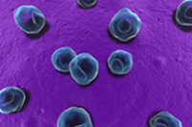
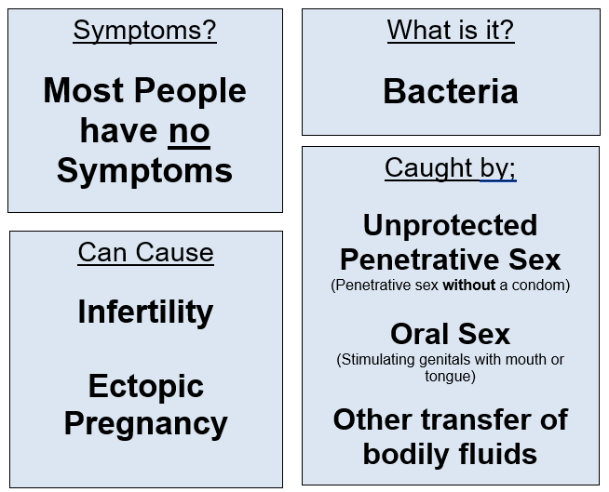
Chlamydia
If symptoms do occur;
  Discharge
  Pain when Urinating
  Swollen testicles
  Pelvic Pain

Slide 9

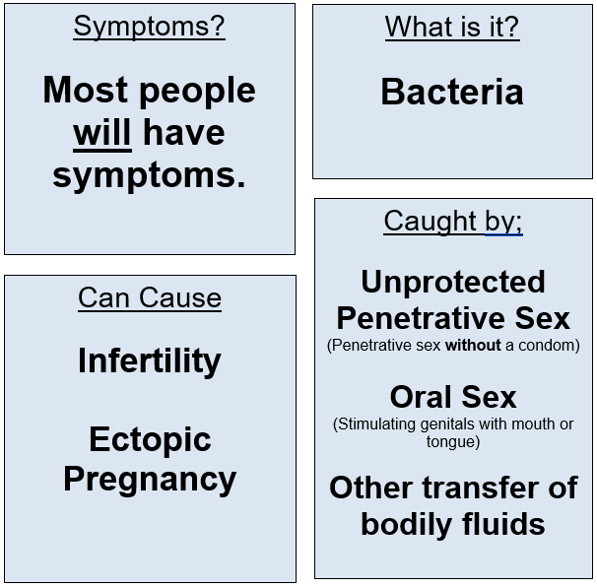
Gonorrhoea
90% of males and 50% of females will have symptoms.
Can include;
  Discharge (& unusual smell)
  Pain when Urinating
  Swollen Testicles
  Pelvic Pain
Beware Super-Gonorrhoea!

Slide 10
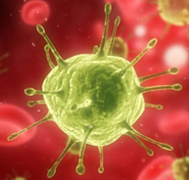
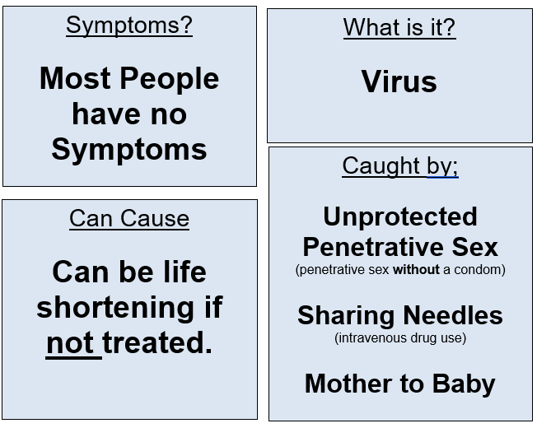
HIV
Individuals may get flu like illness a few weeks after infection, which subsides.
Treated & well managed HIV infection poses very little risk of onward infection.

Slide 11
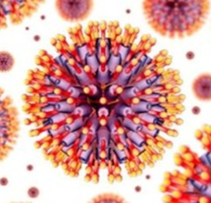
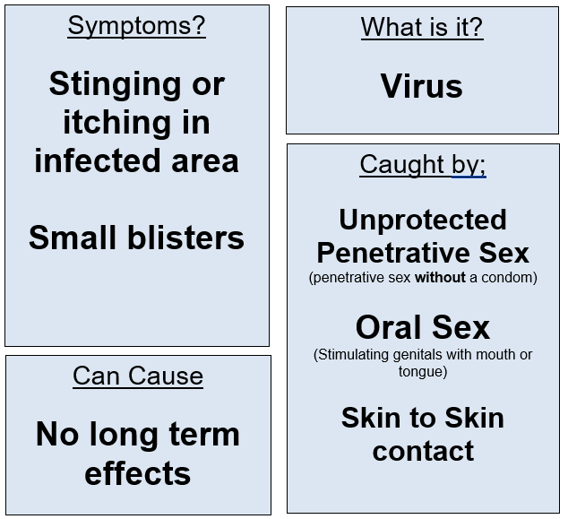
Genital Herpes
Presentation of Genital Herpes very similar to “Cold Sore”
Virus remain in body and recurrence varies but usually stop after 18-24months.

Slide 12
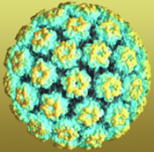
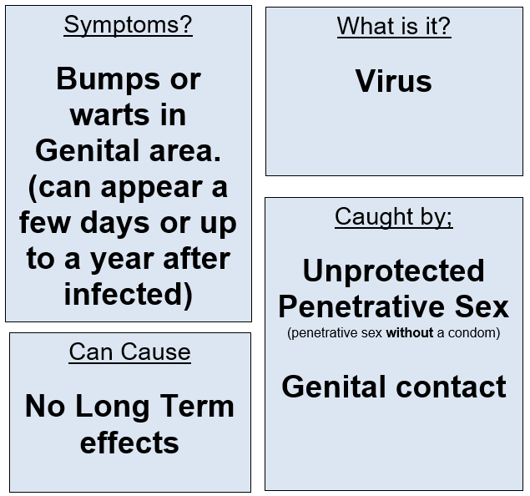
Genital Warts
For some genital warts will only appear once, but for many recurrence can occur.
Warts can take up to 18months to develop after initial infection.

Slide 13
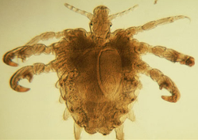
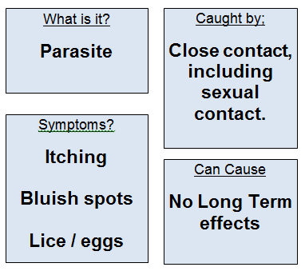
Pubic Lice
Pubic Lice can live in any body hair except hair on head.
Can be treated through shampoos / lotions bought from Pharmacies. (note; Head Lice treatment does not work!)

Slide 14
Quick Quiz
All statements are True or False
There are over 450,000 STI diagnosed each year in the UK.
You can always tell if you or someone else has an STI.
Some STI’s can have serious consequences, and even leave you unable to have children.
Notes:
Use this as a summary exercise to help embed learning by asking students to answer the statements in the same manner as first time. (ie hole either Red or green cards up depending on whether or not they think statements are true or false.

Slide 15
Quick Quiz
You can get some STI’s just by having skin to skin contact.
Not all STI’s can be cured.
Condoms offer good protection against common STI’s
You can access Sexual health Services confidentially even if you are under 16.
Notes:
As previous slide

Slide 16
Further support;
Services available;
  Sexual Health Service; Tel; 01422 261370
Home community based services;
  Type “Calderdale sexual health” in to any internet search engine to access information on local services.
Notes:
Explain local services are available to support anyone and as shown in the previous slide these are confidential, which means the only people who will have any information are those who are directly involved in your treatment. The only time confidentiality will be broken is if the clinician thinks someone is at risk of significant harm in which case they will speak to safeguarding colleagues within the service.

